Slide 1
Fire Monitoring System
IOT Course
By: Mansoor Ahmad
Supervisor: Dr. Chayakorn Netramai
10th May, 2023

Slide 2
Contents
Problem Statement
Solution Features
Solution Architecture
Activity Diagram
Sequence Diagram
Synchronization & Assumptions
Webpage
Email Module
Demo
Q/A

Slide 3
Problem Statement
Lack of timely fire prediction in
Indoor: Warehouses / Data Centers
Outdoor: Forests / Mountains
Reasons for unnoticed fires
Human unavailability
Human inaccessible locations
No remote notifications
False Negative Prediction
Lack of quantification
Lack of visualization

Slide 4
Solution Features
Quantify Smoke
pm2.5 sensor
Get Visibility
picamera: 1920 * 1080 image
Ring Buzzer
Email Notification
Multiple Recipients
Smoke Quantity
Captured Image
Hyperlink to Live Monitoring
Live Monitoring Webpage
Smoke Quantity
Captured Image
Timestamp
One-Way Solution (limitation)

Slide 5
Solution Architecture Activity Diagram
Start
Initiate Smoke Sensor
Starting Sensor Thread
NO
smoke_qty >
threshold
YES
Ring Buzzer
cache
Initiate Camera
Starting Camera Thread
Send Email
Initiate Server
Starting Server Thread

Slide 6
Solution Architecture Sequence Diagram
Beginning End
Smoke Sensor
Camera
Module
Sensor Thread
Camera Thread
Server Thread / Gateway
Server Frontend
smoke_qty
If Smoke
Detected
frame
smoke_qty
Display Smoke Quantity
frame
Display Image
time
Display Time

Slide 7

Solution Architecture Synchronization & Assumptions
Beginning End
Smoke Sensor
Camera
Module
Sensor Thread
Camera Thread
Server Thread / Gateway
Server Frontend
$$>$$
Display Smoke Quantity
smoke_qty / second
(-inf)
smoke_qty / second
frame / 2-second
Rename the file w.r.t gct time
Annotate the image w.r.t gct time
frame /
2-second
Display Image
Is the information available at receiver end ?
Is the information synchronized b/w source & target ?
time
Display Time

Slide 8
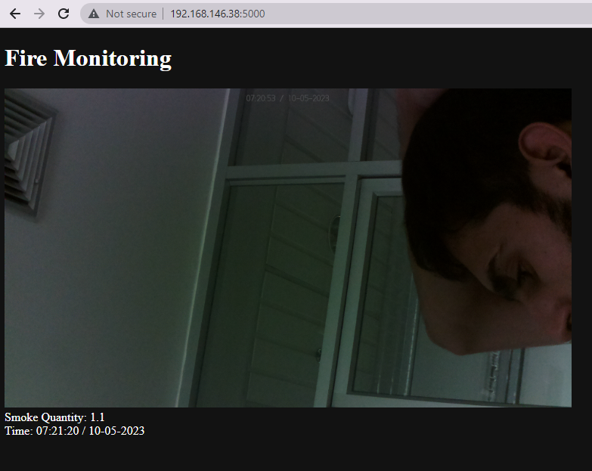
Webpage

Slide 9
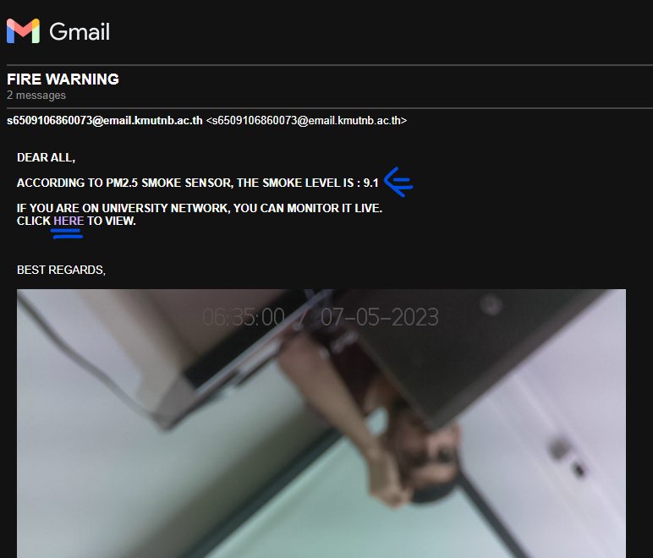
Email Notification

Slide 10
Demo

Slide 11
Thanks ! Github Code Link: https://github.com/malodhi/Fire-Monitoring-System Any Questions ?

